Slide 1
Recruitment Process
Name:
Instructor:
Date:

Slide 2
Introduction
Recruitment is essential in enabling an organization to identify and hire skilled workforce.
The process involved in the recruitment exercise has been demonstrated in the attached diagram.
The recruitment process proposed in the diagram has seven steps of vacancy approval, selection preparation, advertisement, short listing, interviewing, employment offering and employment commencement.

Slide 3
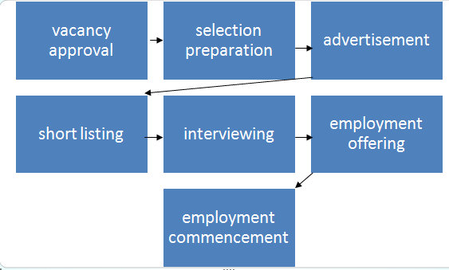
Recruitment Process

Slide 4
Recruitment Process
The first step of vacancy approval entails the determination and approval of a given vacancy arising due to retirement, resignation or emerging need of establishing a position in the organization.
The approval is made by the human resource manager with the recommendation from the department head in the given vacancy.
The second step is advertising for the vacancy that has been approved to attract potential candidates to fill the position.

Slide 5
Recruitment Process
Thirdly, the various candidates applying for the job are short-listed based on their qualifications they have demonstrated.
The shortlisted candidates are invited for interviewing under the fourth stage.
The interviewing of the shortlisted candidates involves assessing their ability to perform the tasks associated with the advertised position.
Equally, the candidates are screened to check their history in ensuring the best are selected.

Slide 6
Recruitment Process
The sixth step involves offering employment to the most qualified candidates from the interview conducted.
The interviewed candidates are screened to determine their ability of fitting within the organization and performing the assigned tasks.
Lastly, the selected candidates commences the employment under the monitoring of their supervisors to identify the deficiencies they pose individually.
This stage enables the organization to plan on the training and career development strategies to employ in enhancing their performance.

